Slide 1
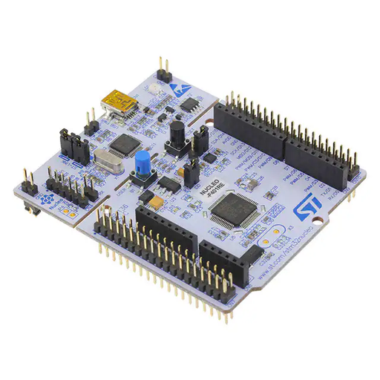
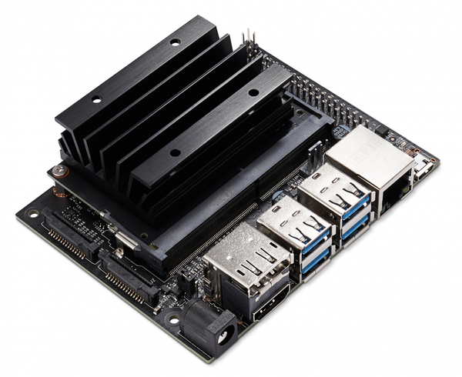
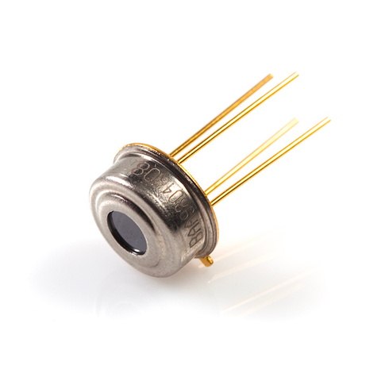
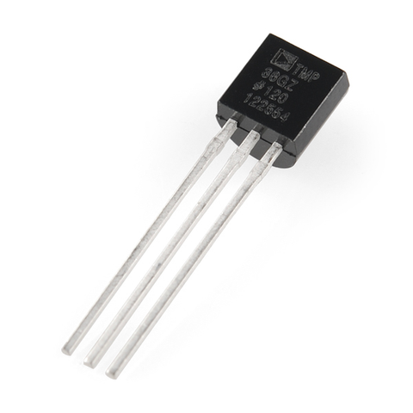
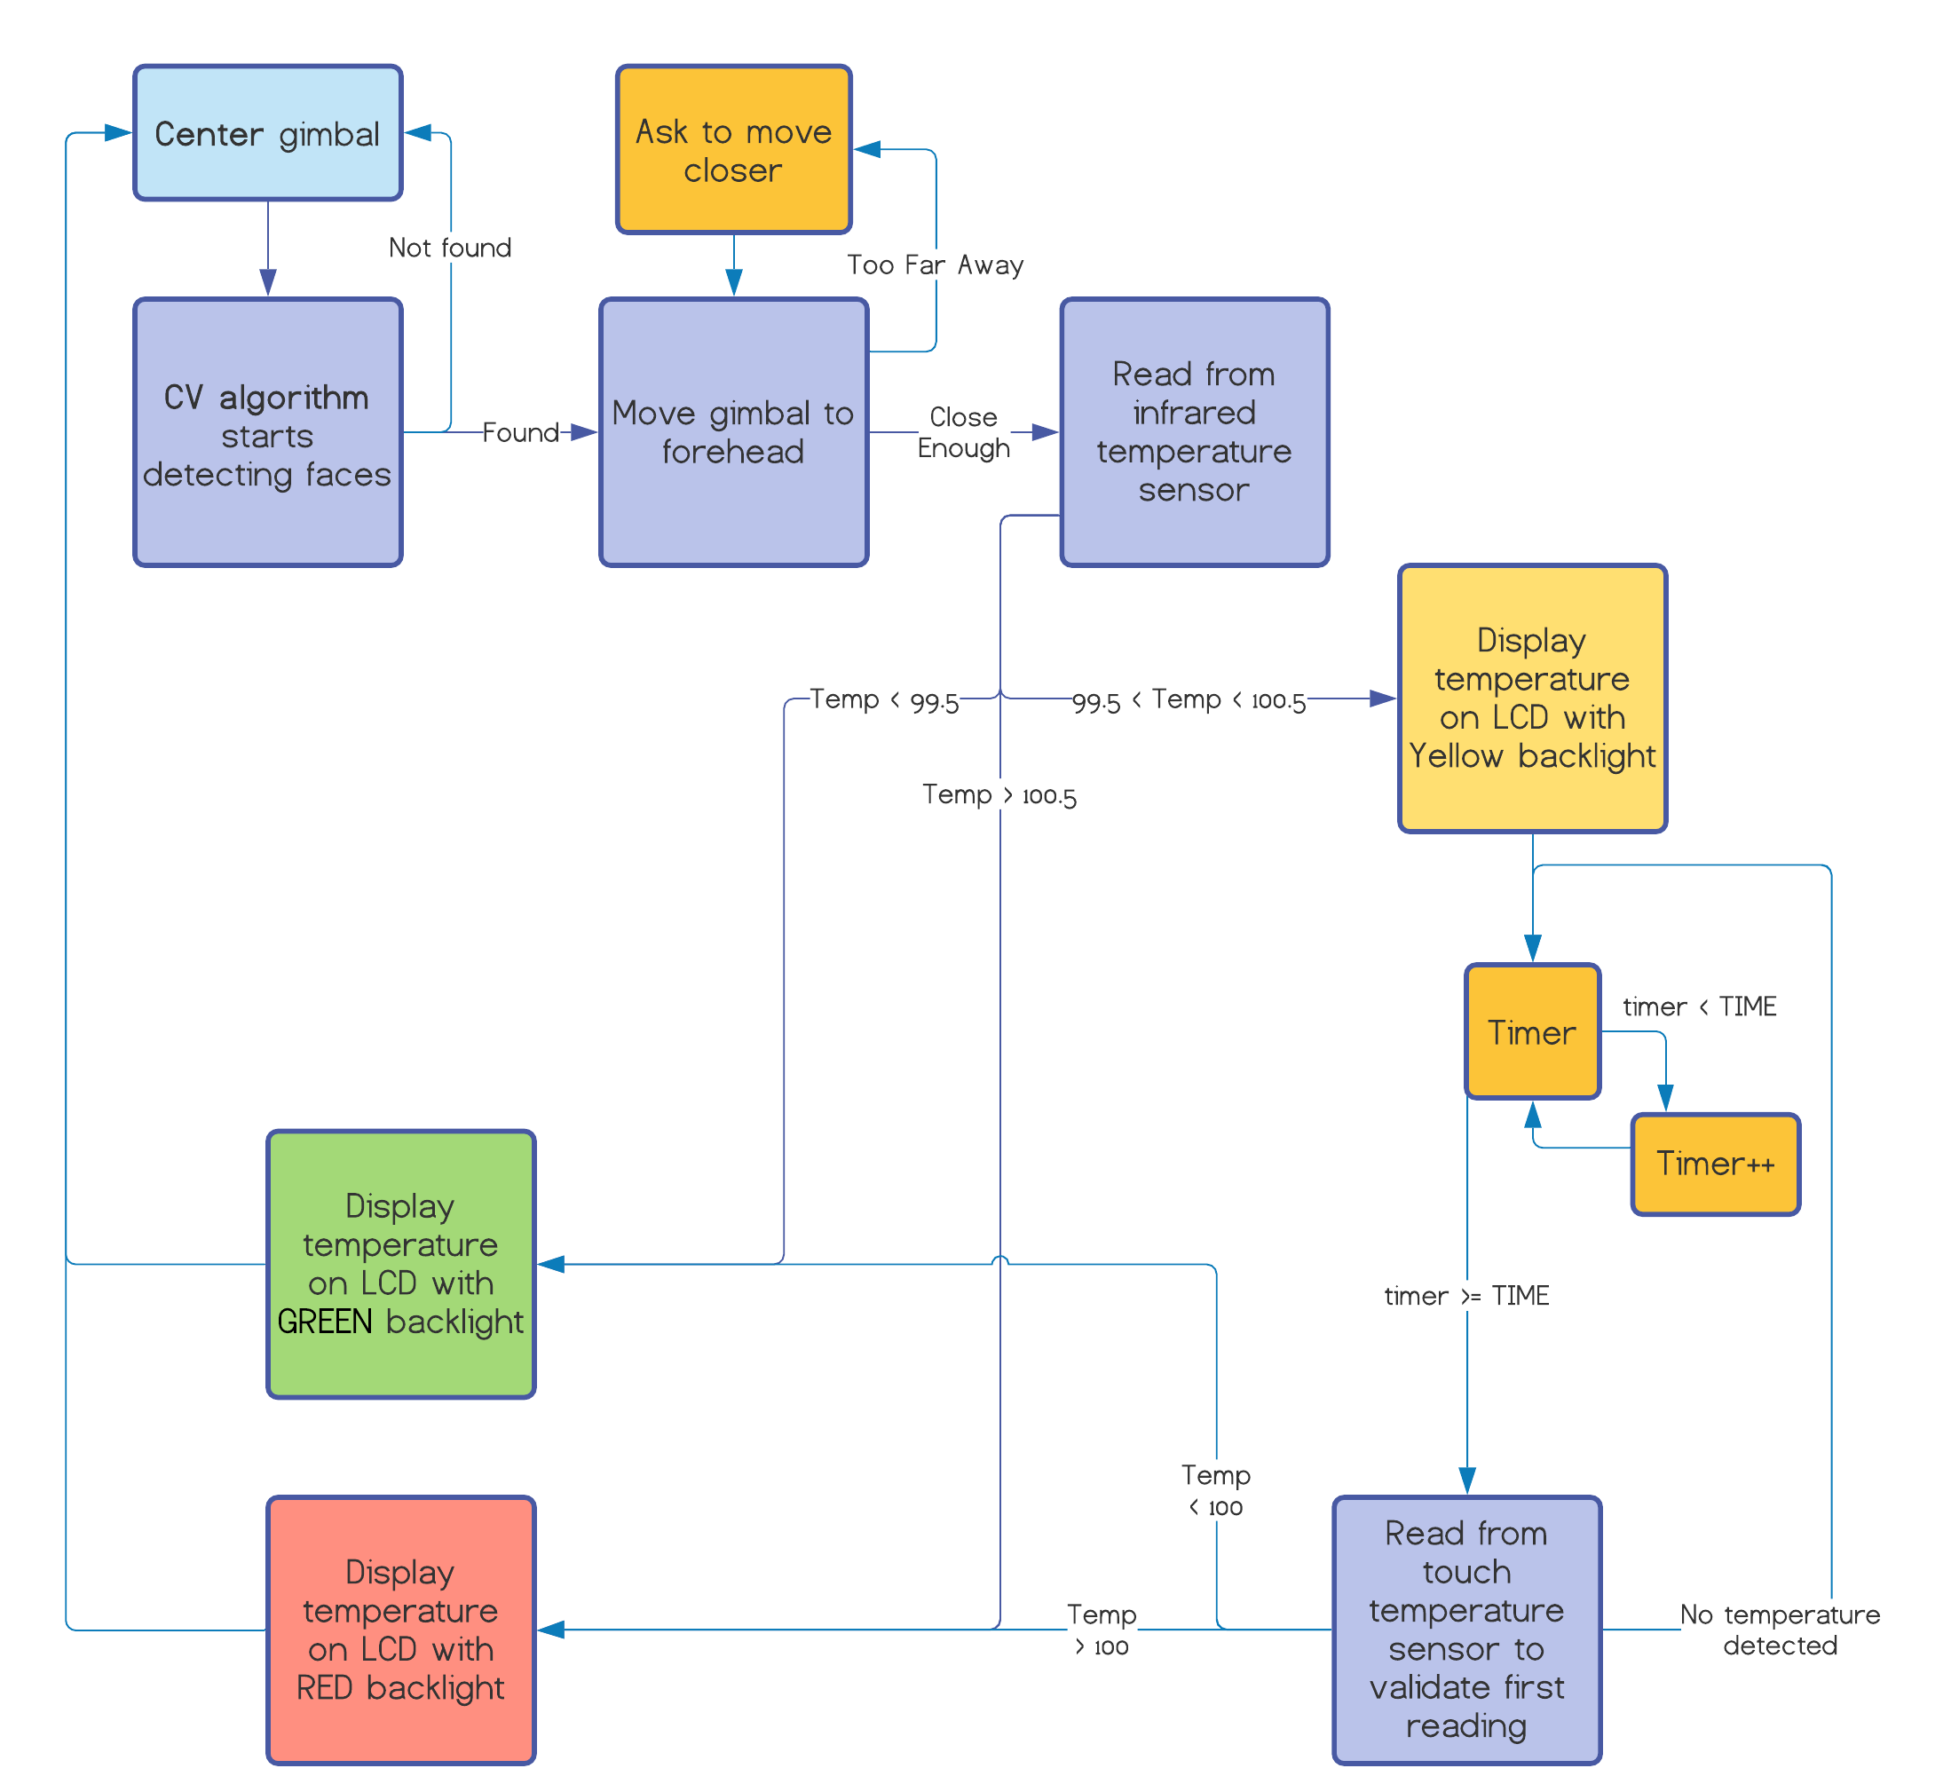

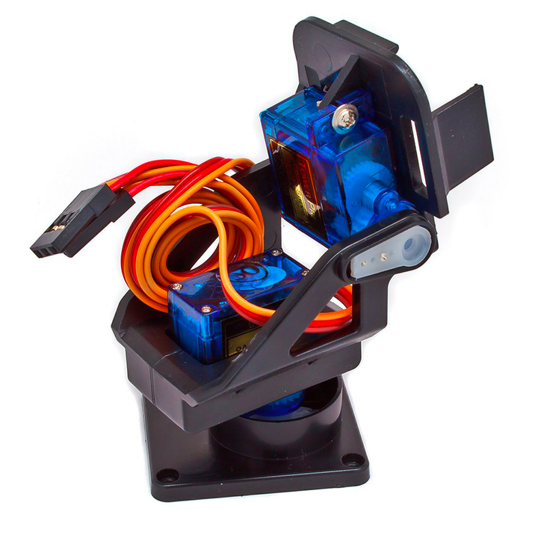
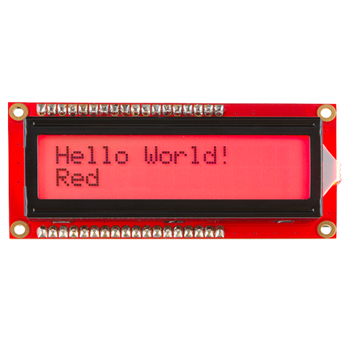
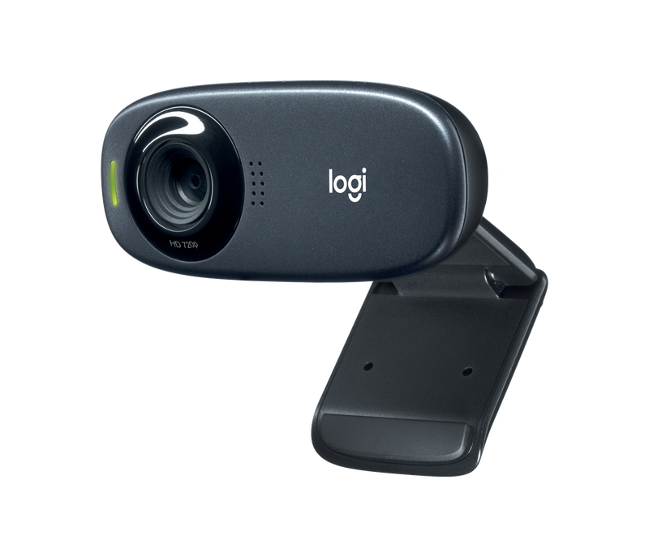

FEVER SENSOR
Abdulqader Khidir, Andrew Kent, Andrew Plotner, Anjana Malayarasan, Rutvi Shah
Hardware
NUCLEO F401RE
STM32 microprocessor development board that controls the entire system. Takes input from camera/ Jetson Nano, and temperature sensors. Controls gimbal servos and sends output to displays.
Authors
Be proud of your work! Add the names of the people involved in this study. Don't forget to include titles and honorifics. We're proud of those too.
Abstract
Objective
Affiliations
We're also proud of the institutions that we are with and support our research. Let's let them know by adding their names and logos here.
NVIDIA JETSON NANO
Small, powerful computer that controls the computer vision portion of the system. Detects the forehead and signals sensor.
During the pandemic, taking human temperature readings from a distance is necessary in most establishments. Hiring to complete this task is costly and detrimental to workflow in job shortages. A device is being designed to test and verify users as they enter buildings or pass checkpoints. The device consists of a thermal sensor (Melexis MLX90614) and camera (Logitech C310) detecting human faces and following their movements using a 2 axis gimbal. When centered on a forehead, the thermal sensor reads and displays temperature data using a color LCD (Sparkfun LCD-16396). If the temperature is not satisfactory the system requires a user to hold a touch temperature sensor (Analog Devices TMP36) to get a more accurate reading of temperature. This approach improves accuracy and uniformity of temperature sensing and allows easy notice to interested parties of possibly hazardous associates.
Living in a time of a pandemic it is necessary to develop machines to improve the lives of others and keep the public safe. To reduce the staffing shortage in an impactful manner while keeping risk of exposure to a minimum.
Related literature
Research is often built on something that is already out there. Cite key references that you looked at while conducting your study.
Future Research
INFRARED TEMPERATURE SENSOR
No-contact Forehead Thermometer. Detects temperature and send output to microprocessor.
The need of long-range thermal sensors is of utmost importance, as it will allow medium to large scale testing of the system. A printed circuit board (PCB) for final connections is in development. Advancements in mounting hardware and case designs are necessary and are to reach further development after PCB design.
ANALOG CONTACT TEMPERATURE SENSOR
Touch temperature sensor provides voltage output proportional to the absolute temperature
Code Logic
SERVO GIMBAL
2-axis gimbal. Allows the camera to follow the movement of the person.
RGB LCD DISPLAY
Displays temperature and information in an easily visible format, also has a multicolor backlight to convey information at a glance.
CAMERA
Allows the Jetson Nano to see the world around it and process human faces.

